Slide 1
Can a Computer Play a Clinician Role to Clinical Diagnosis? The Features and Feasibility of Modern Precision Medicine Technology
Research Proposal
Louie LU
OCT-2020

Slide 2
Presentation Overview
1. What is Precision Medicine?
2. The Research Purpose
3. Motivation
4. Theoretical framework
5. Research Method
6. Expected Outcome
7. Timeline

Slide 3
What is Precision Medicine?
Definition:
Precision Medicine (PM) is a more widely concept which contain precision treatment, medical and clinical decision support, precision healthcare to specific patients, etc. (National Research Council (US) Committee, 2011)
National Research Council (US) Committee (2011) define it as the customization of healthcare, the opposite of a one-drug-fits-all model.
The most profound and distinctive feature of PM still belongs to Machine Learning (ML), Deep Learning (DL), and Artificial Intelligence (AI) (Filipp, F. V., 2019)
In this paper, the precision medicine(PM) could be considered as a bridge of medical treatment to the individual characteristics of each patient.

Slide 4
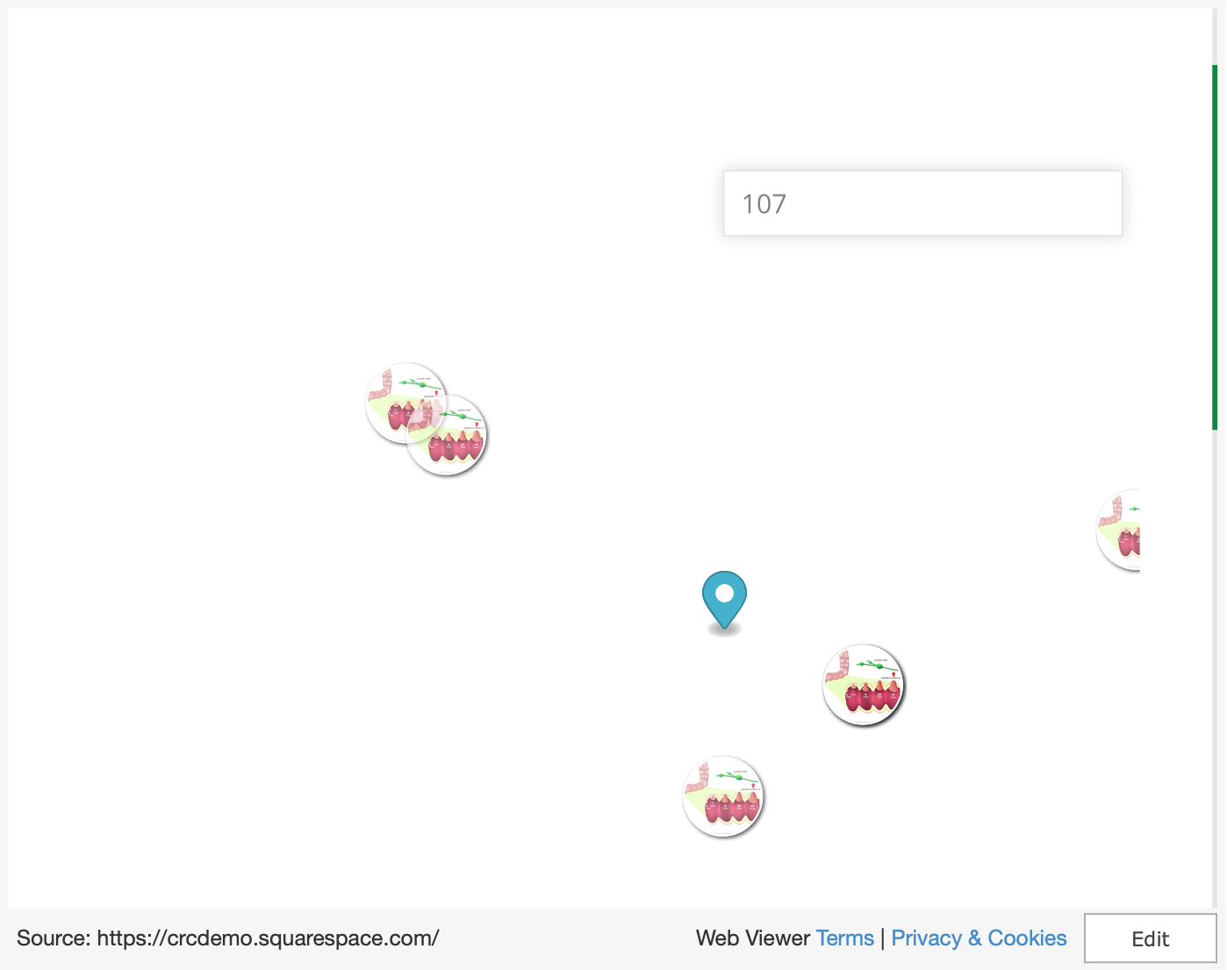
Precision Medicine EHR Demo Similar CRCs Patients
Input:
A Patient’s Symptoms
Output:
Other Patients with the same Symptoms

Slide 5
Research Purpose
1. What’s the main challenge of clinical diagnosis?
2. Which aspect of Precision Medicine helps the most in clinical diagnosis?
3. Can a Computer Play a Clinician Role to Clinical Diagnosis?
(The corresponding technology to the diagnostic process)

Slide 6
Motivation
Discover a state-of-the-art PM solution to replace traditional clinical diagnosis process through studying the information system research in Healthcare and Medical area.
UN 17 Sustainable Goal 3 : Ensure healthy lives and promote well-being for all at all ages. Since the low cost of PM clinical diagnosis, the average improvement of diagnosis for the patients who are living in unconditional area would be increased significantly.

Slide 7
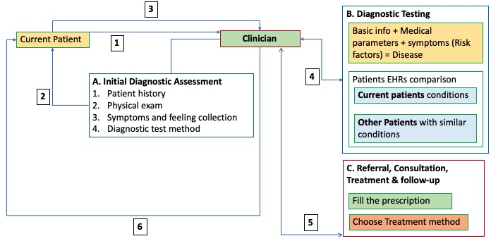
Theoretical Framework
The Framework is based on General Clinical diagnosis process (CRICO Strategies, 2014)
A. Initial Diagnostic Assessment
B. Diagnostic Testing
C. Referral, Consultation, Treatment & Follow-Up
How does precision medicine replace the components in above framework? (PM: Machine learning, Deep learning, Artificial Intelligence)

Slide 8
Research Method
Research Method: The Grounded theory (Glaser & Strutzel, 1967)
Conceptual framework, Data collection, Data analysis:
Openness:
Previous researches, Hypotheses, Ethics, Philosophical perspective
Analysing immediately
Coding and comparing:
Clinical diagnosis articles (Methods + Issues)
PM articles
(Methods: ML, DL, AI)
Comparison targets:
1.PM method cover the clinical diagnosis issues.
2.PM method replace the diagnosis process.
3.PM method can self-study like clinician.
4.PM method has better performance than above three targets.
Memo-writing:
Matching status
Special cases
etc.
Theoretical sampling
Theoretical saturation
Production of a substantive theory

Slide 9
Expected outcome
The final expected outcome is to build a clinical diagnosis flow via PM.
The PM has potential to improve its method through the theory building.
Preliminary study and expected result:
DP
ML
AI
ML
DP
ML
ML

Slide 10
Timeline
Stage | Description | Date
Research objective | Understand and verify the value of the research via reading the paper on Web of Science Core Collection. | 2 days OCT-2020
Prior works review | Review the relevant and similar research articles in common topic, study the advantage results and focus on the limitation, find out the research gap. | 1 weeks DEC-2020
Theoretical framework | Choose a research theory which is the most appropriate to the research. | 2 days DEC-2020
Research method confirm | Based on the theoretical framework, select some achievable methods for data collection and analysis, estimate whether it can approach the expected outcome in advance. | 3 days DEC-2020
Perform research | According to the research unit are articles and journals, there are two tasks: data collection and data analyze, the major part is to grasp the essential principle from the papers. | 2 weeks DEC-2020
Result analysis | Make conclusion, and analyze whether the result is deviated from expectations. Discuss the outcome and limitation. | 3 days DEC-2020

Slide 11
Question Time
Thank you!

